Slide 1
IPL VISUALISATION
By Ankita Divya

Slide 2
PROBLEM STATEMENT
This visual representations aims to create an infographic for a newsletter for The Indian Premier League highlights which was founded in 2008 and is held every year.
It sees participation from both national and international players, and eight teams representing eight Indian cities compete with each other in a double round-robin format in the league stages, which are followed by playoffs.

Slide 3
Modularizing the Problem statement
Dividing the overall insights of IPL into several categories. - Match Statistics - Player Statistics - Team Statistics

Slide 4
Match-wise Analysis

Slide 5
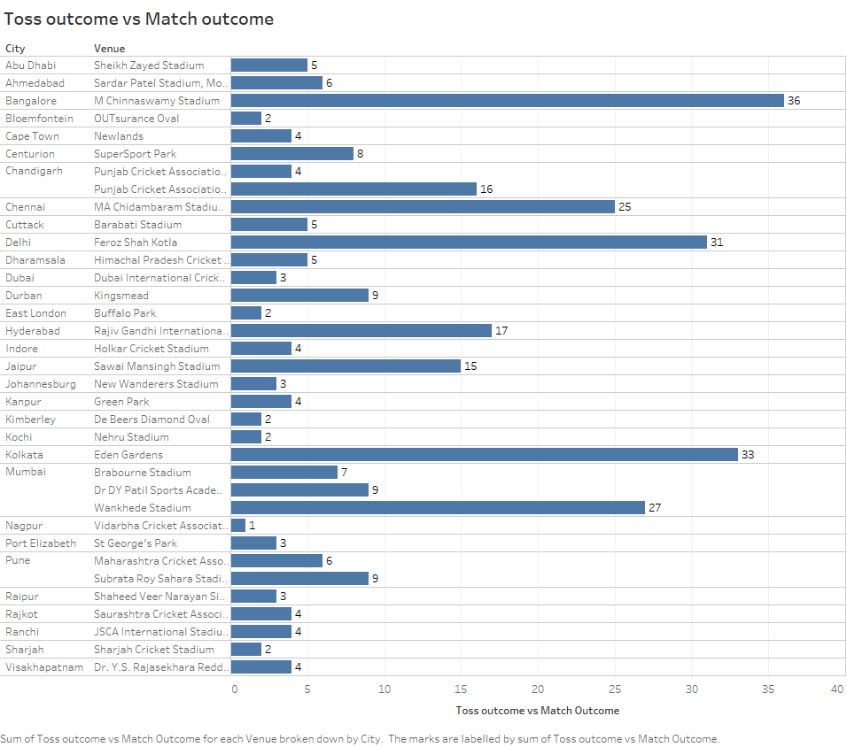
Toss outcome vs Match outcome
DISTRIBUTION OF TARGET VARIABLE

Slide 6
The highest number of winners of toss and match both is seen in Bangalore, M Chinnaswamy stadium which is 36.
This is followed by Eden gardens, Kolkata at 33.
The lowest toss outcome vs match outcome is 1 at Nagpur, Vidarbha cricket Association.
The toss winner and match winner is 2 for :
1] Bloemfontein
2] East London
3] Kimberley
4] Kochi
5] Sharjah

Slide 7
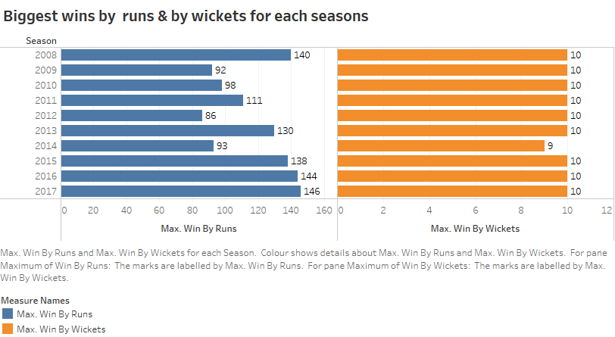
Biggest wins by runs & by wickets for each seasons

Slide 8
From the graph we can see that In 2007, 146 matches were won by runs followed by the trend in 2008 where 140 matches were won by runs
For all most all the years total matches won by wicket were approaximately 10 except in 2014 where only 9 matches were one by wickets
Lowest number of matches which were won by runs happened in 2012 and 2009 having 86 and 92 matches won respectively
We could conclude that there are more number of matches won by runs than the number of matches which are won by wickets.

Slide 9
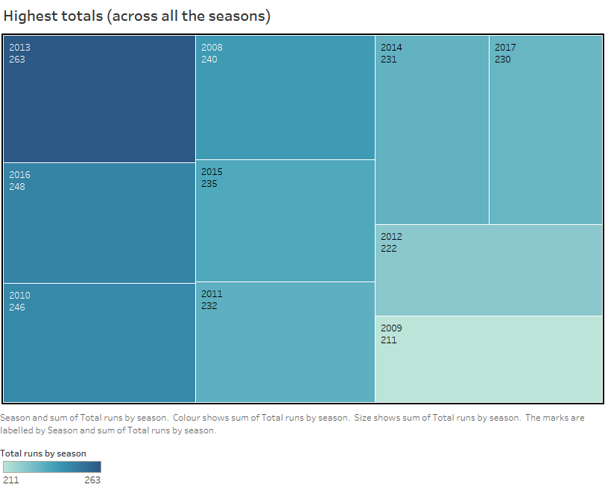
Highest totals (across all the seasons)

Slide 10
From the graph we can see that the highest runs across all seasons were score in 2013 which is of 263 runs
we can also visualize that the lowest runs across all seasons were score in 2009 which is of 211 runs
On an average 237 runs were scored on every season being the range from 211 to 263

Slide 11
Player-wise Analysis

Slide 12
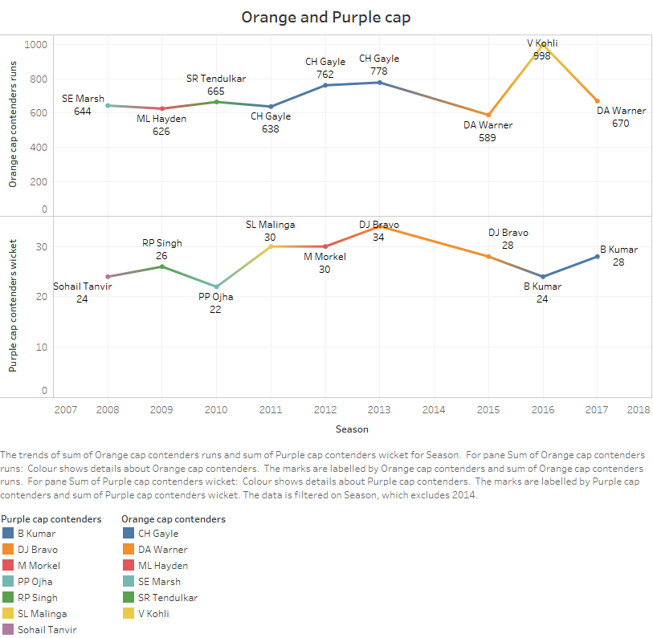
Orange Cap contenders - The batsmen who have scored the maximum number of runs in a particular season.
Purple Cap contenders -The bowlers who have taken the maximum number of wickets in a particular season.

Slide 13
As seen in the previous plot, the highest runs scored among all the Orange cap contenders was by Virat Kohli while the lowest among the orange cap contenders is DA Warner
Also, among the purple cap contenders the highest number of wickets taken was by DJ Bravo and lowest number of wickets taken among all the purple cap contenders was by PP Ojha

Slide 14
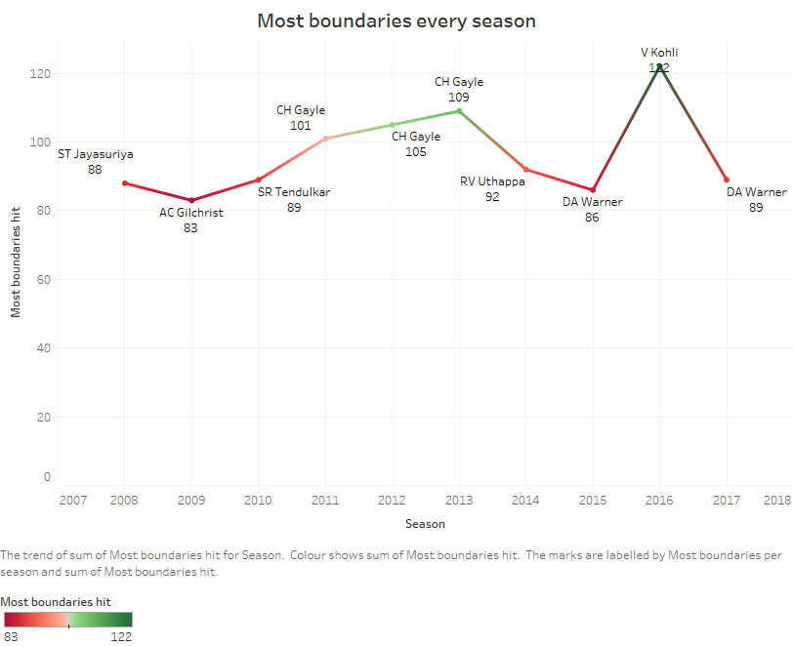
Batsmen who have hit the most number of fours and sixes (per season)

Slide 15
As seen in the previous plot, the most boundary hit by any player is 122 by Virat Kohli and least is by AC Gilchrist which is 83
CH Gayle was the only batman who has hit most number of boundaries in three consecutive year starting from 2011 till 2013 with 101, 105 and 109 number of boundaries.

Slide 16
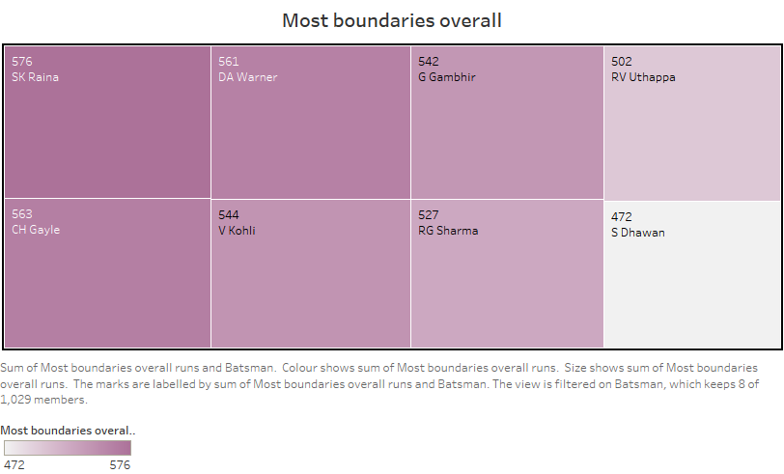
Batsmen who have hit the most number of fours and sixes (overall)

Slide 17
As seen in the previous plot, the most boundary hit by any player overall is 576 by SK Raina and least among top 8 is by S Dhawan which is 472
CH Gayle and DA Warner scored approximately similar number of boundaries having 563 and 561 number of boundaries respectively overall in all the seasons.

Slide 18
Team-wise Analysis

Slide 19
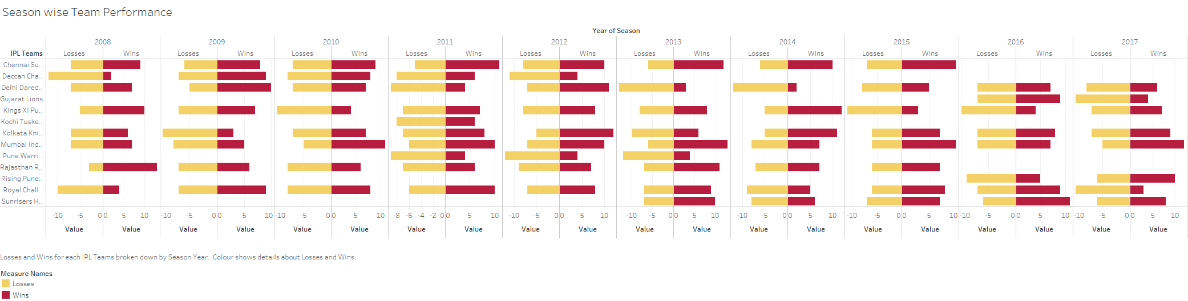

Slide 20
As seen in the previous plot, the chennai Super Kings have performed really well in all over the seasons having most wins.

Slide 21
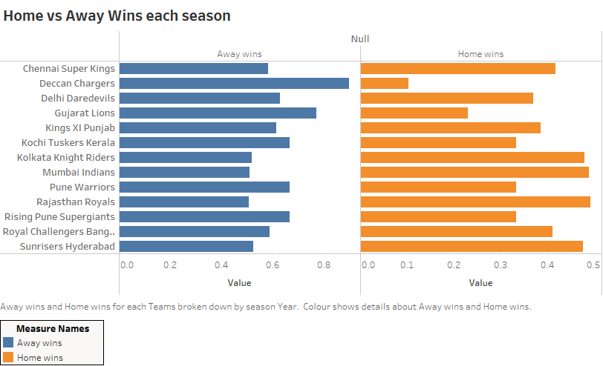

Slide 22
As seen in the previous plot, there are more home wins than away wins. Teams like Chennai Super Kings, Kolkata knight riders, Mumbai Indians and rajasthan royals have shown similar trends.

Slide 23
Summarizing the Different aspects
Toss
Winning of toss impacts the Match outcome. We saw that if the toss is won chances of winning the match increases.
Win by runs
Most of the wins were won because of highest runs and very less number of matches were won by wickets
Home Wins
The trends for the winning of match also illustrated that if the team is playing in its home ground chances of winning the match increases

Slide 24
CONCLUSION...
Winning of toss impacts the Match outcome. We saw that if the toss is won chances of winning the match increases.
Most of the wins were won because of highest runs and very less number of matches were won by wickets
The trends for the winning of match also illustrated that if the team is playing in its home ground chances of winning the match increases

Slide 25

THANKS!
IPL Dataset available at:
https://learn.upgrad.com/v/course/834/session/155495/segment/834138

